Slide 1





Visual Exploration of Relationships and Structure in Low-Dimensional Embeddings
Klaus Eckelt, Andreas Hinterreiter, Patrick Adelberger, Conny Walchshofer, Vaishali Dhanoa, Christina Humer, Moritz Heckmann, Christian A. Steinparz, Marc Streit
klaus.eckelt@jku.at
@klaus_lml
https://jku-vds-lab.at/vis22-eckelt

Slide 2
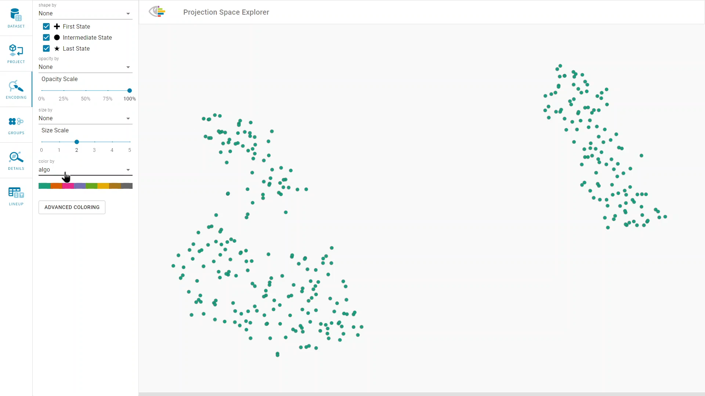
Color coding
https://jku-vds-lab.at/vis22-eckelt
Notes:
palmers penguin datase
three different species, that live on 3 Antarctic islands
←- click to color code →
color code the points by species to see whether the penguins are different ….… which is the case.

Slide 3
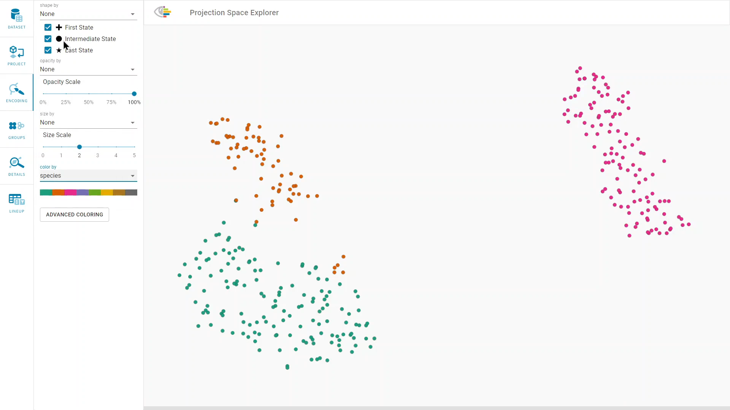
Shape coding
https://jku-vds-lab.at/vis22-eckelt
Notes:
But how are they different? By their weight, their size, the island they are on?
← Click to add shape encoding →
encode the penguin’s island by shape. We could also do it by color, but than we loose the information of the species.
how to represent structure in an embedding
← Click to create groups →

Slide 4
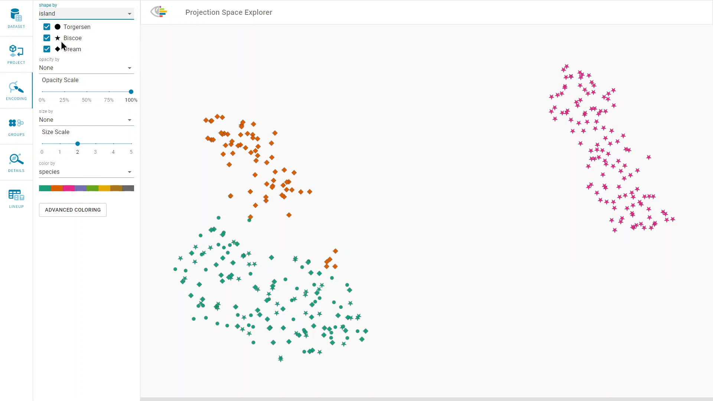
groups
https://jku-vds-lab.at/vis22-eckelt
Notes:
represent groups with diamond symbols
rendered on top of the marks.
The diamond is placed at the centroid of the groups’ points in the embedding.
summary visualizations give an overview over the high dimensional data.
outliers

Slide 5
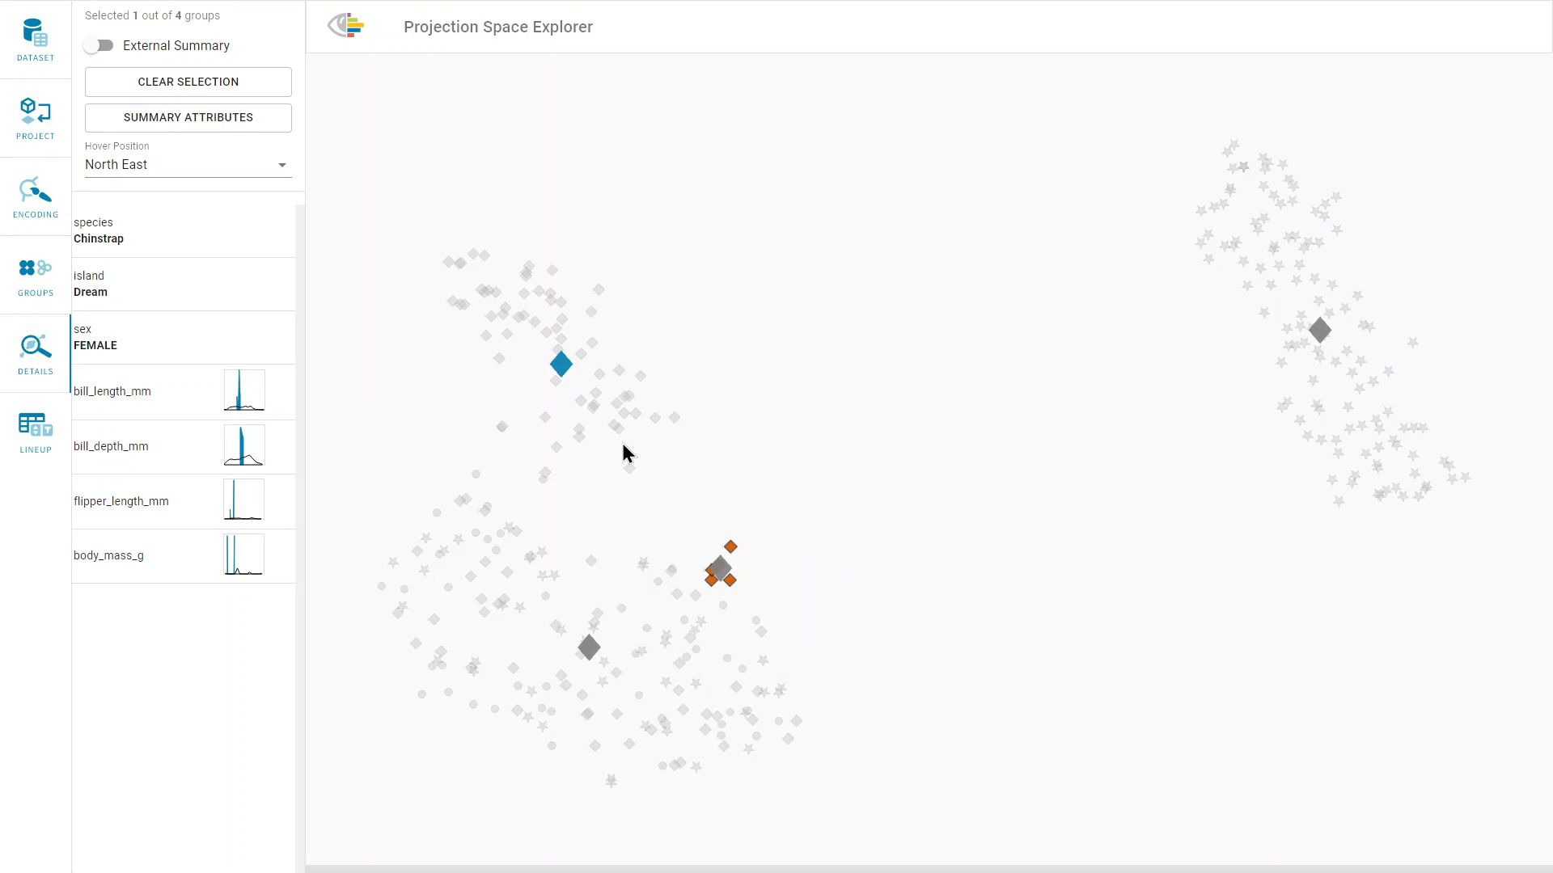
relationship
https://jku-vds-lab.at/vis22-eckelt
Notes:
Edge to outliers
This exploration of structures was also the initial motivation for our work, having groups and subgroups defined by certain features in the data, like species or island of the penguins, and analyze if and how they differ
First on a high level in the embedding space
And then in Detail by the high dimensional data

Slide 6
Defining Structure
Single Items
Groups
By User Selection
By Clustering
By (Meta-) Data
🐧
Species
Size
Body Mass
Island
…
…
…
…
…
…
…
Notes:
many different structures and relationships can occur in data
Structure:
* Single items
And groups of items, which can be defined
Based on user selection
Groups can also be defined density-based by applying clustering algorithms to the scatterplot
Or based on the high dimensional data – grouping items of the same category or with similar numerical values

Slide 7
Representing Relationships: Group⮕Group
🐧
Hierarchies
Graphs
Notes:
relationships between groups are represented by directed edge
Click for hierarchy →
← Click for grpahs →
data that changes over time → sequences

Slide 8
Representing Relationships: Item⮕Group
🐧
Notes:
shown on demand by selecting either an item or a group.

Slide 9
Representing Relationships: Item⮕Group
🐧
Notes:
Items: connect to all groups
← Click for animation →

Slide 10
Representing Relationships: Item⮕Group
🐧
Selected points are connected with their groups’ centroids.
Notes:
groups are highlighted

Slide 11
Representing Relationships: Item⮕Group⮕Item
🐧
Notes:
Select a group

Slide 12
Representing Relationships: Item⮕Group⮕Item
🐧
Star Visualization
Contour Plot
Notes:
connect all items
group’s diamond is the centroid of all points in the scatterplot -> star like pattern
alternative:
< click>
The contour plot
overplotting
distribution differences
Next: use case

Slide 13
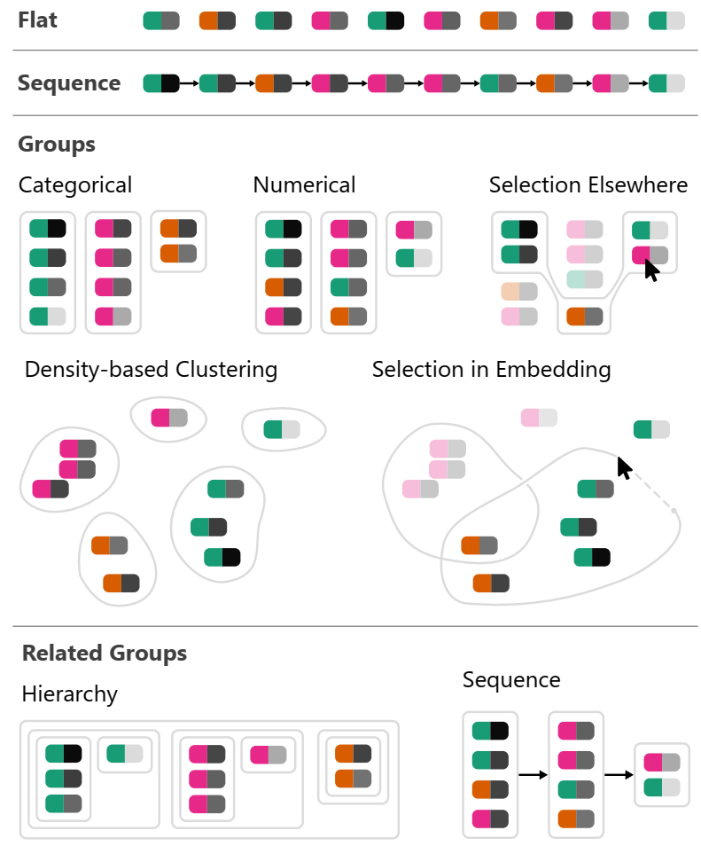
What Kind of Relationships?
What Kind of Structure?
Single Items
Groups
data driven
user driven
density-based
Item Sequences
Hierarchies
Group Sequences
Graphs
Notes:
backup

Slide 14
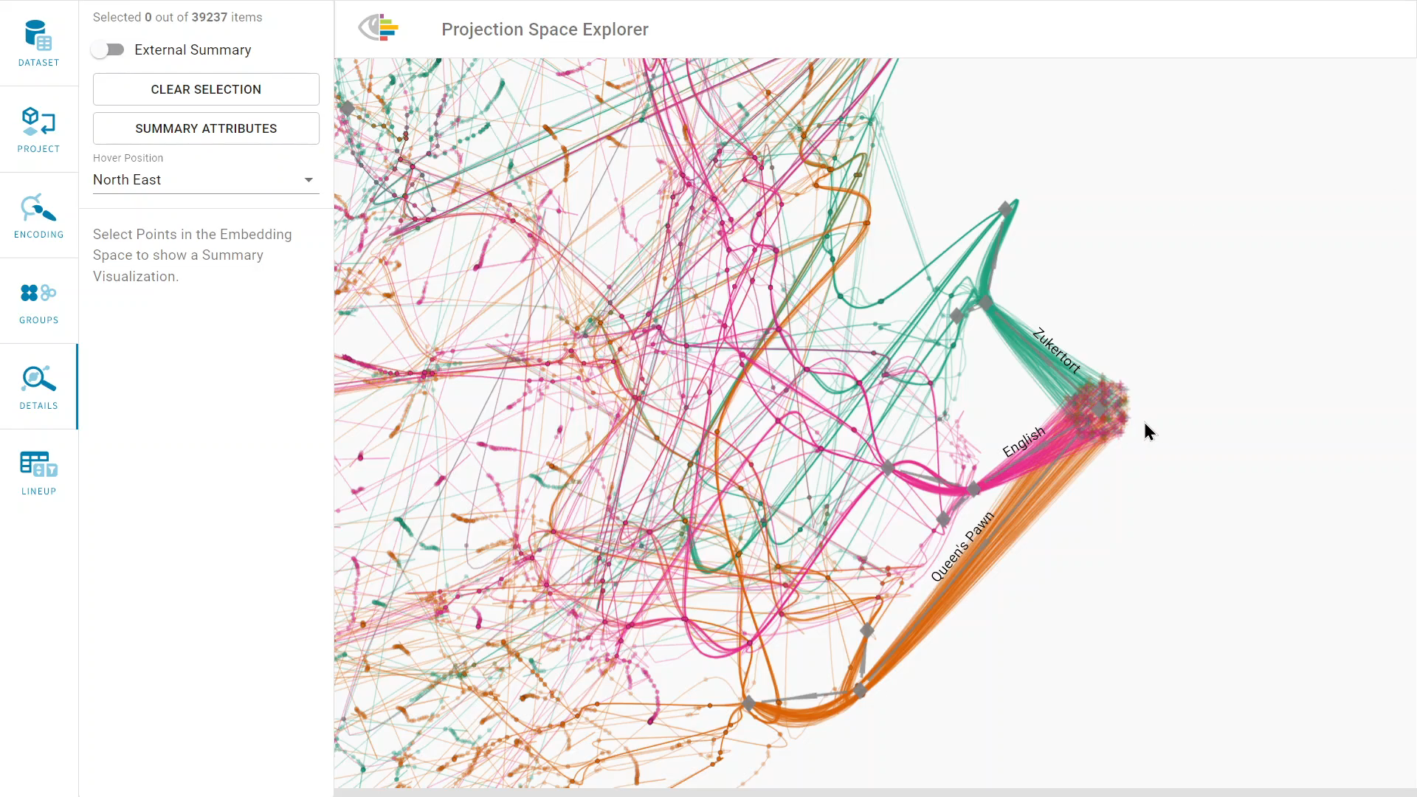
PSE & Data Intro
Notes:
450 professional chess games
sequence of game sates
← Click to play video →
start of the games
← Click to zoom out →

Slide 15

ZOOM OUT
TODO video
Notes:
clusters later in the game
← Click to select →

Slide 16
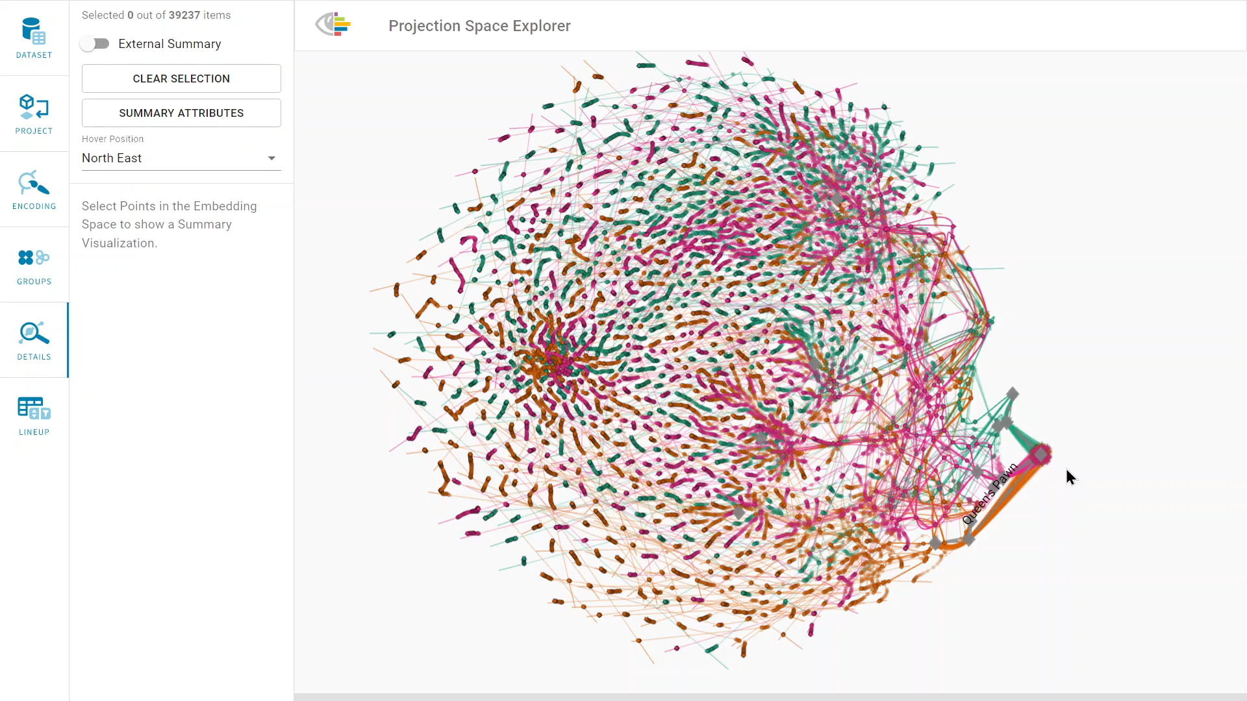
Select groups
Notes:
open the Comparison pane
← Click to go to comparison →

Slide 17
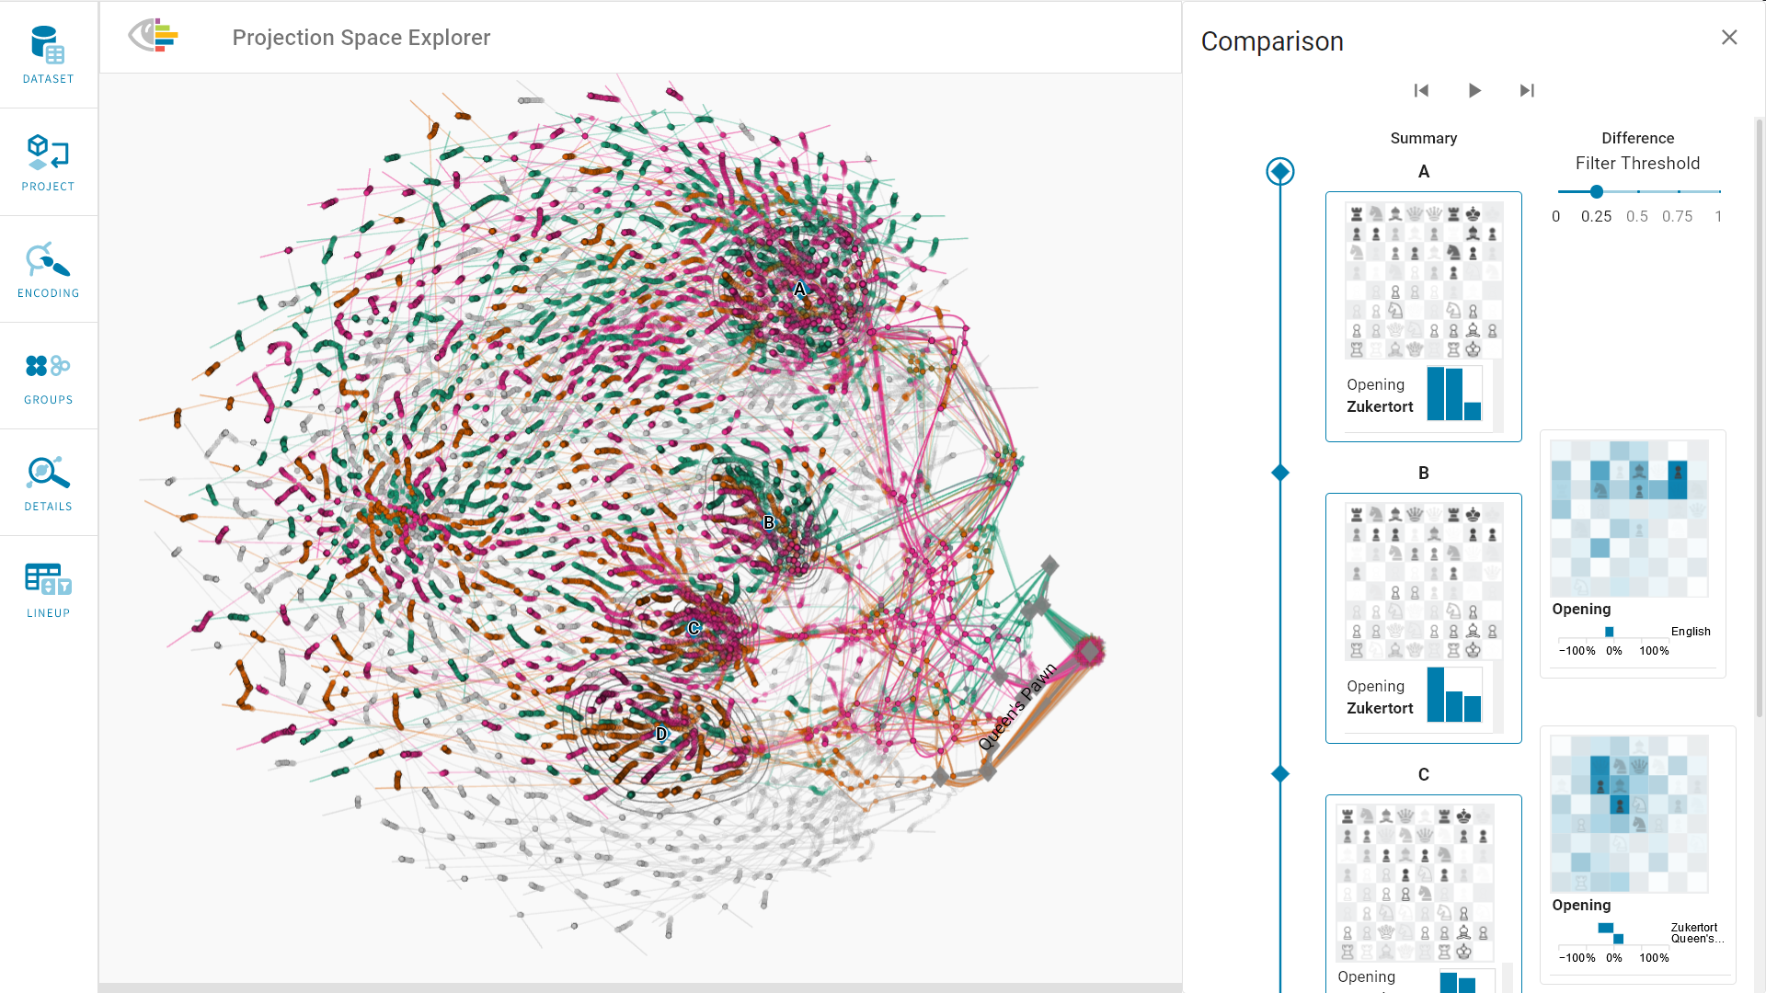
Compare groups
Notes:
encoding
Click to highlight castling →
Castling in all of the groups
← Click to highlight diffs →
Differences:
In the first group, a bishop is in front of the black king , while in group B, a pawn takes this position.
Difference visualization shows respective square in dark blue , together with a pawn.
← Click to highlight diffs →
In the third group, games were opened with a Queen’s pawn opening more often

Slide 18
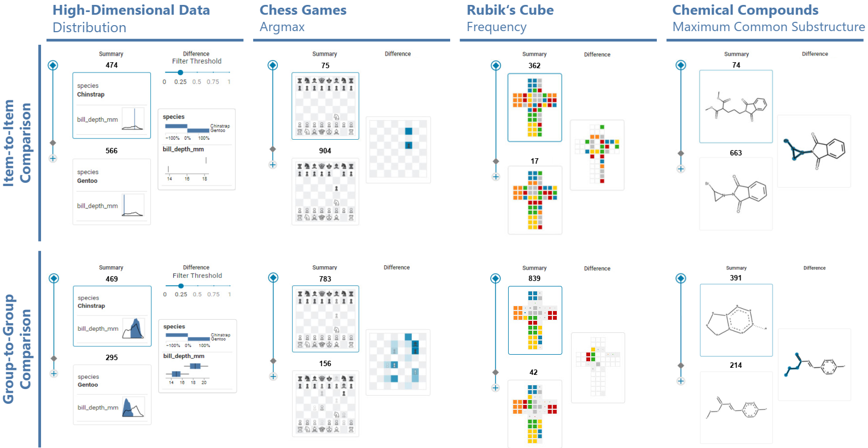
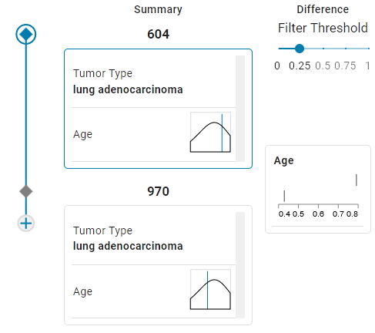
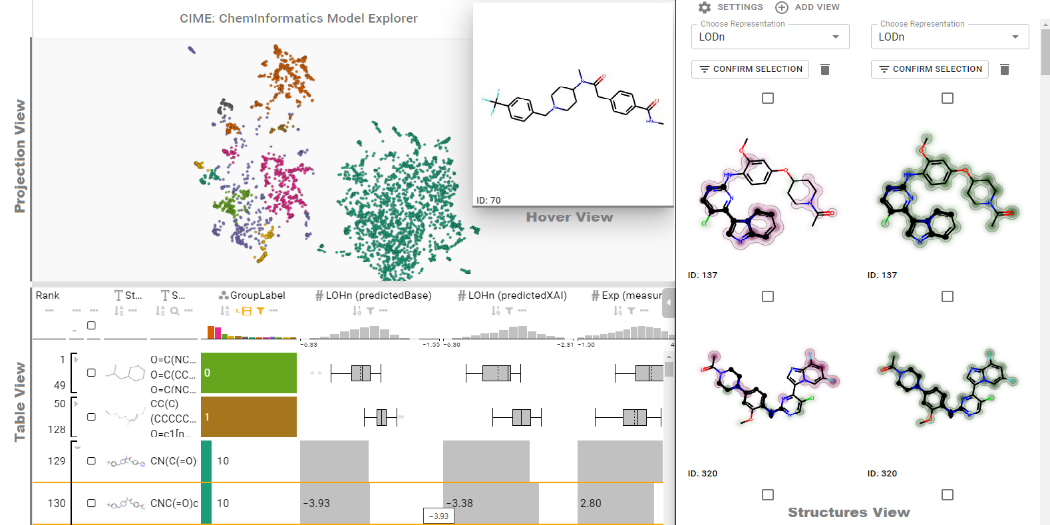
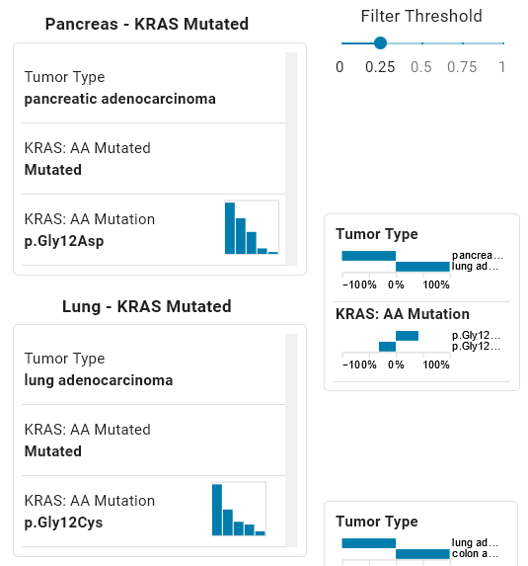
Summary and Difference Visualizations
Humer, C., Heberle, H., Montanari, F. et al. ChemInformatics Model Explorer (CIME): exploratory analysis of chemical model explanations. J Cheminform 14, 21 (2022).
Notes:
Penguins: generic
Charts
Summary
Difference
Ranking of attributes
Summary
Difference
<- click for others ->
Rubiks cube
compounds

Slide 19
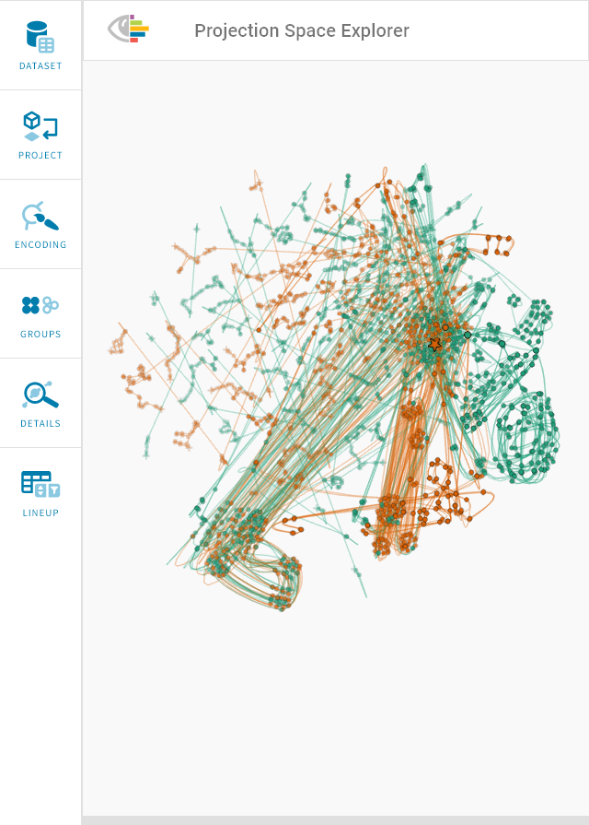
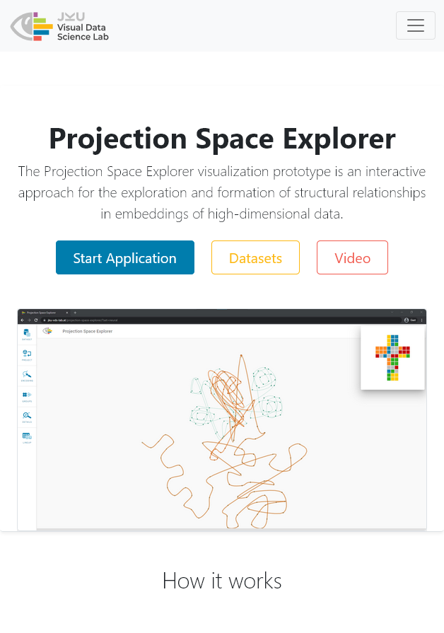
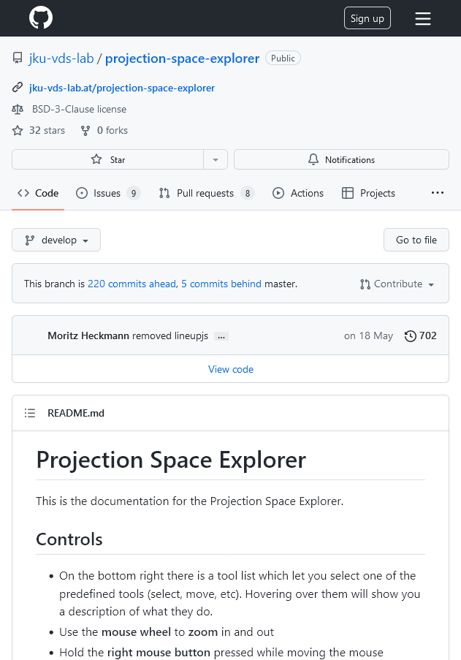
Overview
Online Tool
Library
https://jku-vds-lab.at/pse

Slide 20
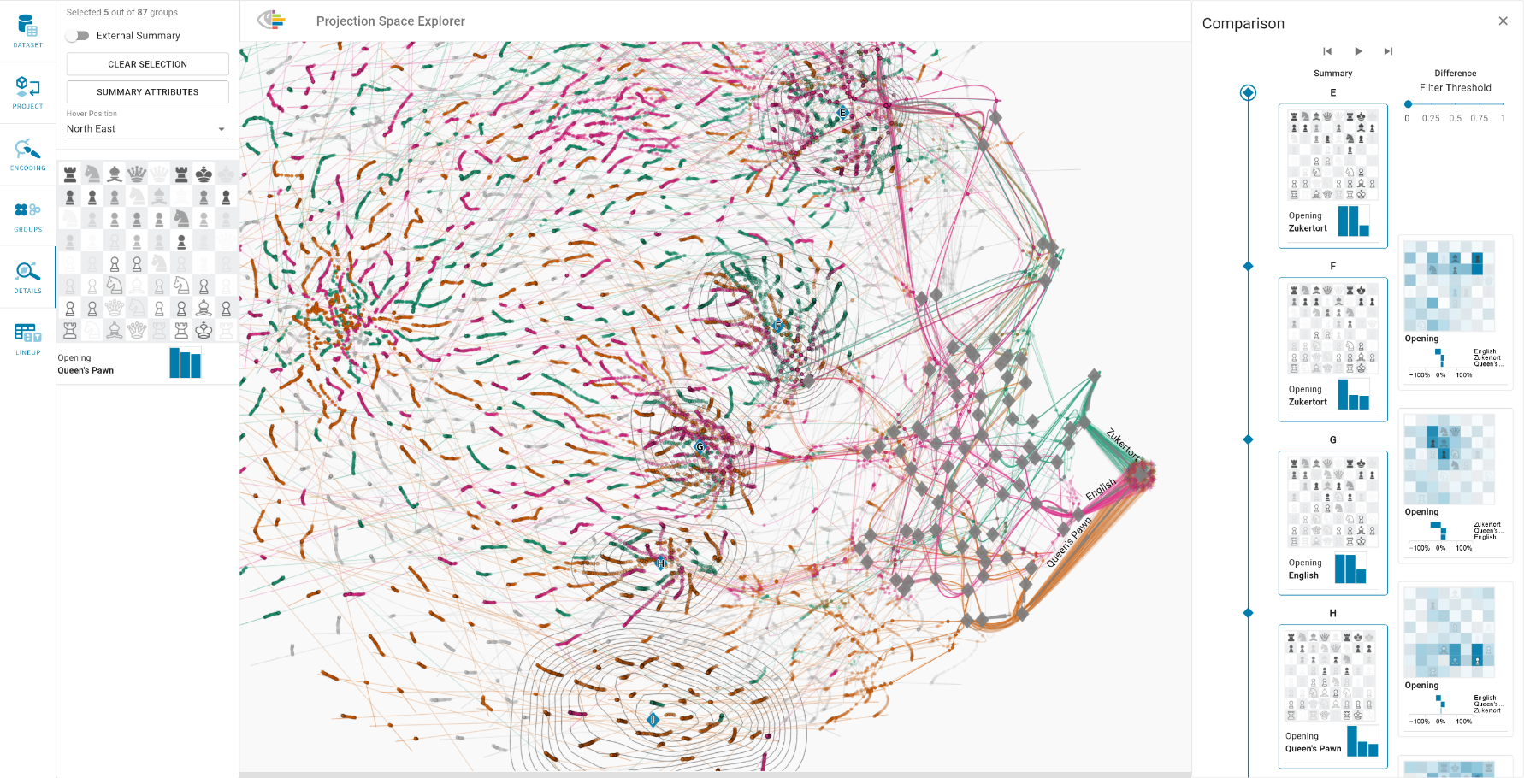
Scalability
Embedding is rendered with WebGL and scales well to 100 000 items
Chess: 100 000 items and 70 attributes
Cancer Genomics: 1238 items and 720 attributes
Notes:
backup

Slide 21
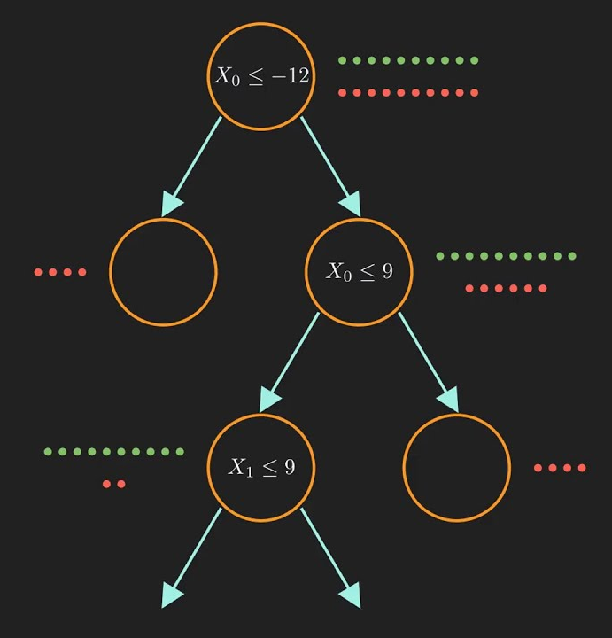
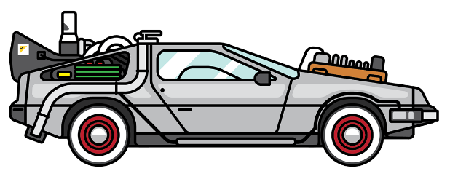
Ongoing & Future Work
Automated Analysis and Storytelling
Comparison by Attribute Combinations
Eckelt et al., Kokiri: Random-Forest-Based Comparison and Characterization of Cohorts IEEE VIS Workshop on Visualization in Biomedical AI
https://jku-vds-lab.at/kokiri
…
…
Image source: https://www.youtube.com/watch?v=ZVR2Way4nwQ
Image source: Jobi Gutierrez
Notes:
groups and group sequences more automated,
← Click for sequence groups →
improve the group comparison.
Click for comparison →
Combinatorial effects of attributes that might separate the groups even better are not considered yet.
Future work in Visualization in Biomedical AI workshop on Monday.

Slide 22
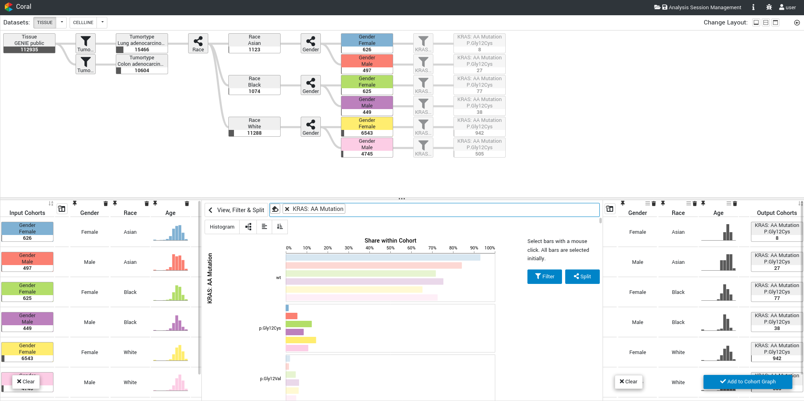
Ongoing & Future Work: Integration in Coral
P. Adelberger, K. Eckelt, M. J. Bauer, M. Streit, C. Haslinger, and T. Zichner, “Coral: a web-based visual analysis tool for creating and characterizing cohorts,” Bioinformatics, vol. 37, no. 23, pp. 4559–4561, Dec. 2021
Notes:
Backup

Slide 23




Visual Exploration of Relationships and Structure in Low-Dimensional Embeddings
Klaus Eckelt, Andreas Hinterreiter, Patrick Adelberger, Conny Walchshofer, Vaishali Dhanoa, Christina Humer, Moritz Heckmann, Christian A. Steinparz, Marc Streit

Slide 24
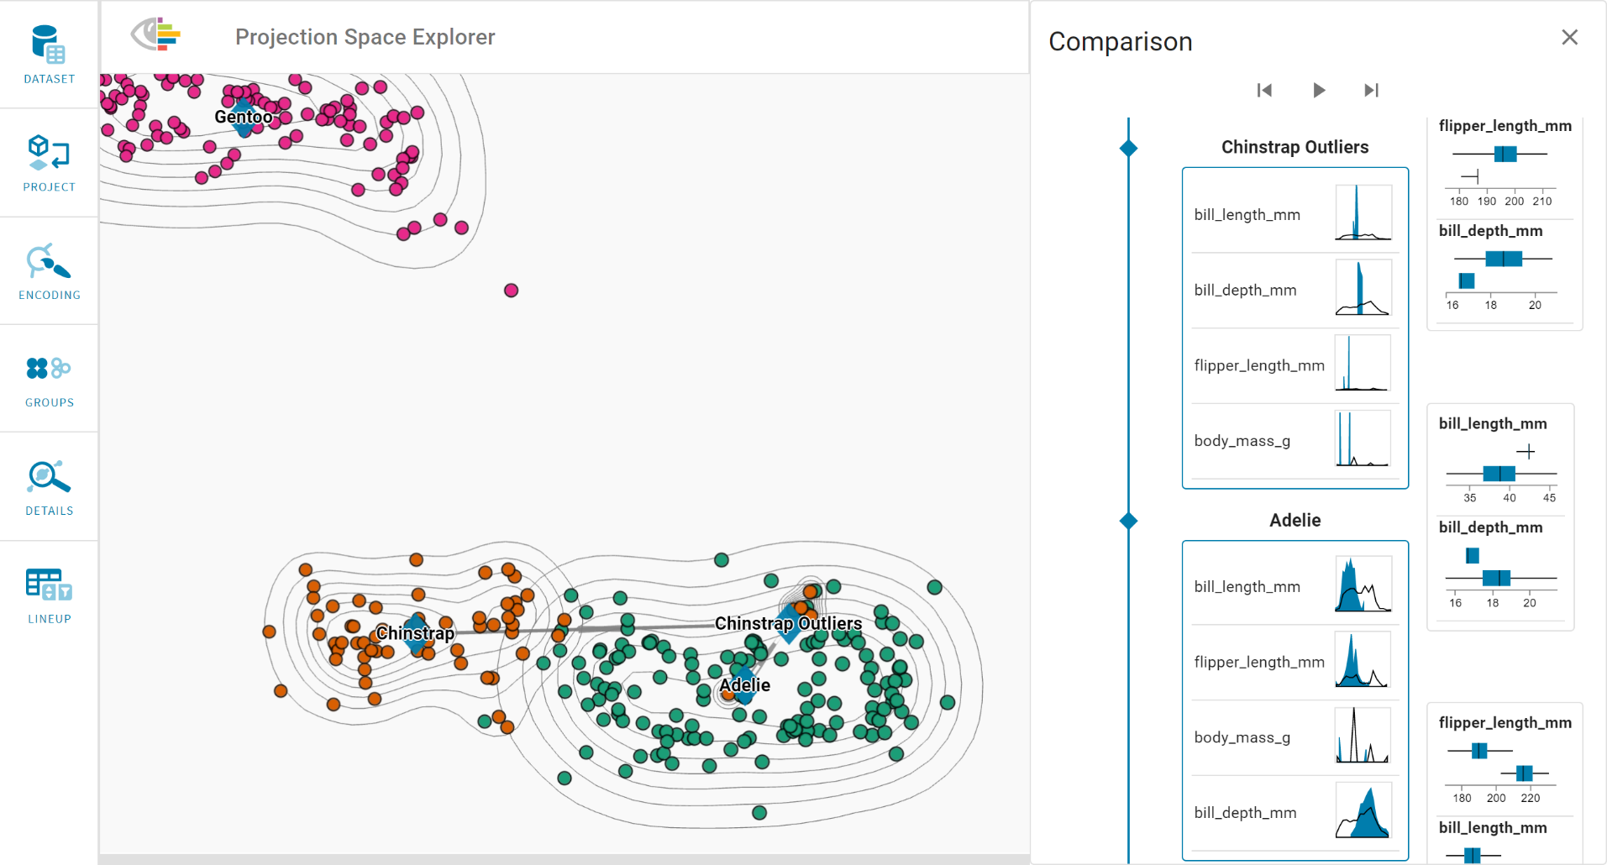
Visual Exploration of Relationships and Structure in Low-Dimensional Embeddings
Klaus Eckelt
klaus.eckelt@jku.at
@klaus_lml
https://jku-vds-lab.at/vis22-eckelt

Slide 25
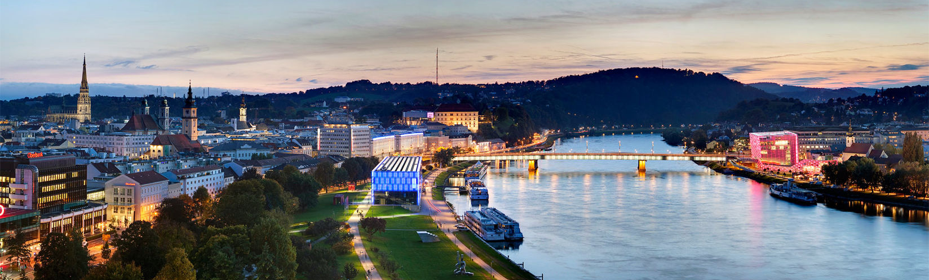
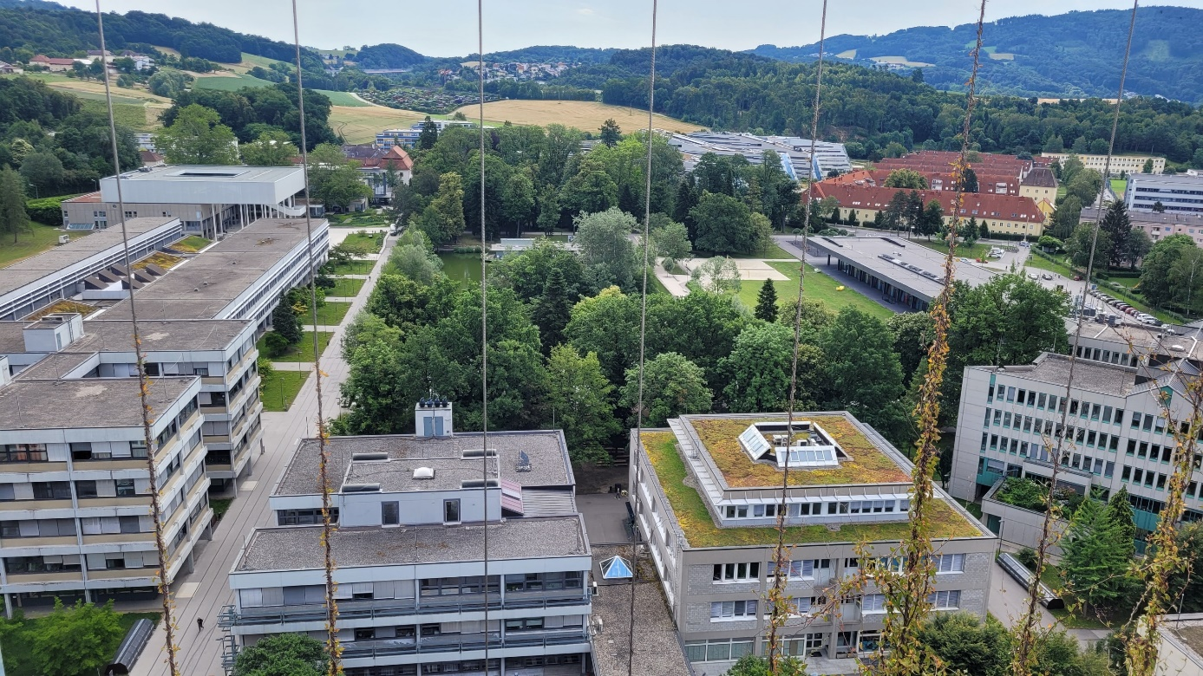
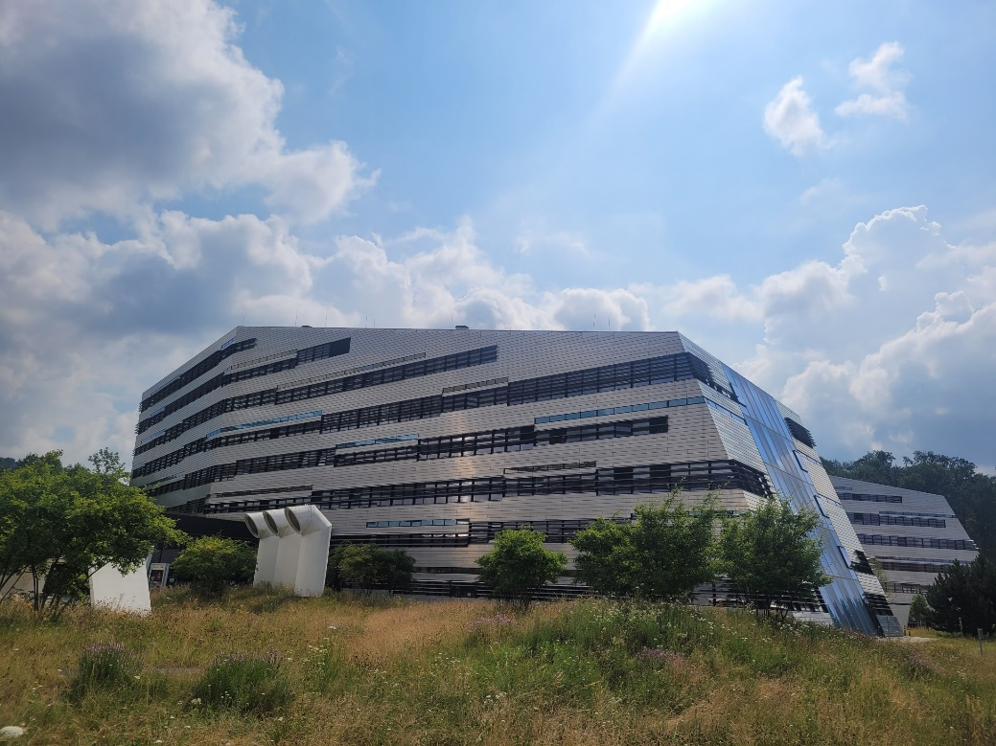

Slide 26
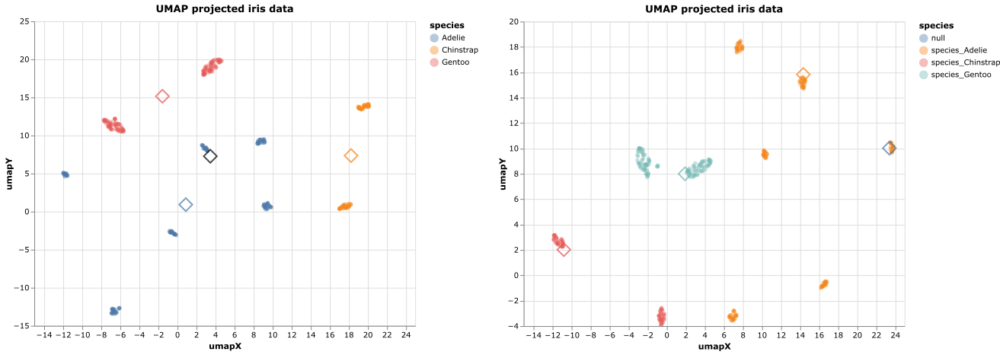
Centroid Positioning
Centroid
Medoid
Notes:
backup

Slide 27
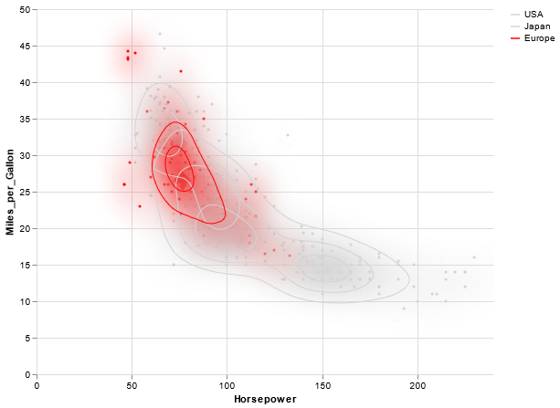
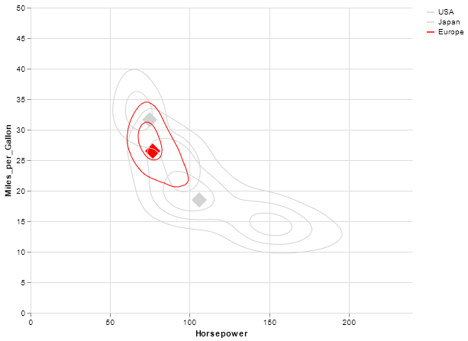
Encoding Group Distribution
Heatmap + Contours
Contours
Notes:
backup

Slide 28
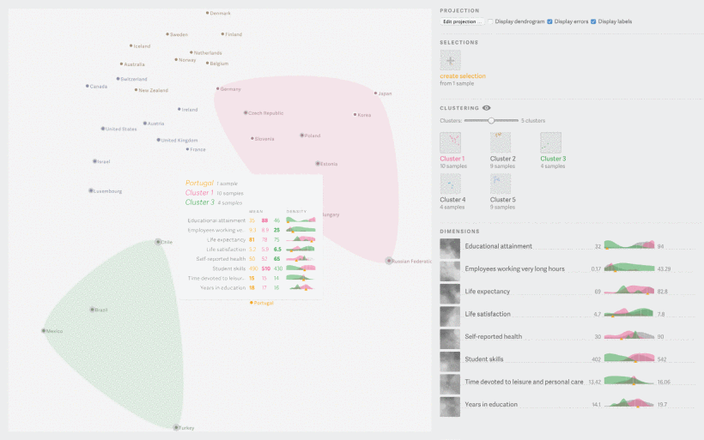
Probing Projections by Stahnke et al.
J. Stahnke, M. Dörk, B. Müller and A. Thom, "Probing Projections: Interaction Techniques for Interpreting Arrangements and Errors of Dimensionality Reductions," in IEEE Transactions on Visualization and Computer Graphics, vol. 22, no. 1, pp. 629-638, 31 Jan. 2016, doi: 10.1109/TVCG.2015.2467717.

Slide 29
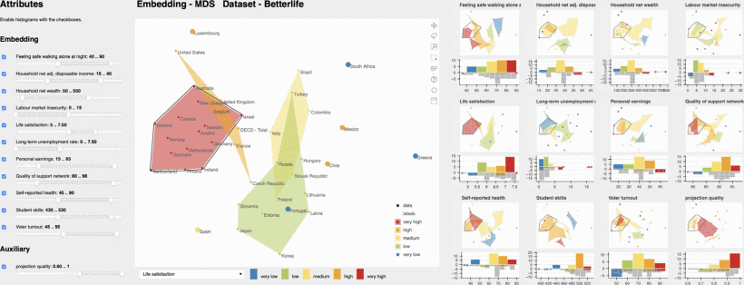
NoLiES by Sohns et al.
J. -T. Sohns, M. Schmitt, F. Jirasek, H. Hasse and H. Leitte, "Attribute-based Explanation of Non-Linear Embeddings of High-Dimensional Data," in IEEE Transactions on Visualization and Computer Graphics, vol. 28, no. 1, pp. 540-550, Jan. 2022, doi: 10.1109/TVCG.2021.3114870.

